Slide 1
WIC Farmers’ Market Nutrition Program
Debra Bolding
Co-Manager Howard County Farmers’ Market
Chairman, Nashville Growing Healthy Communities
Farmers’ Market Vendor Training
January 31, 2017
Hempstead Hall
Hope, AR

Slide 2
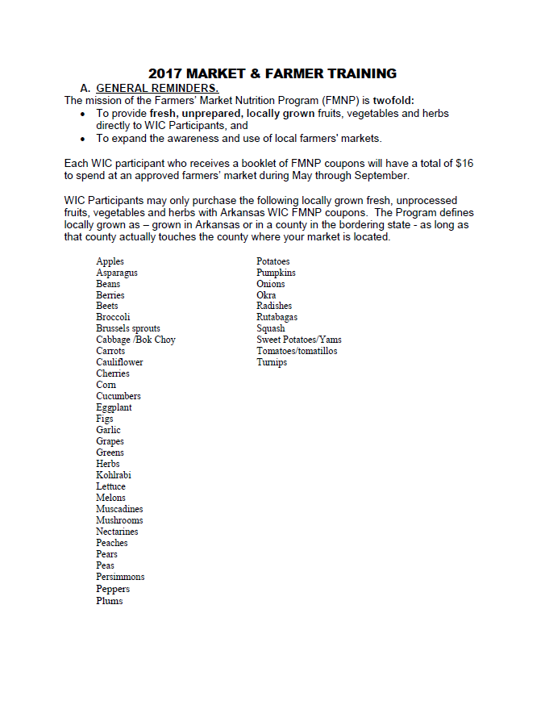
Handout – Take Note!

Slide 3
WIC FMNP
2017-2019 Farmer Training
On your flash drive &
mailed to approved farmers.
Notes:
Is on flash drive!!!

Slide 4
WIC FMNP
2017-2019 Farmer Training
WIC – Supplemental Nutrition Program for Women, Infants and Children
Participants are:
Women who are pregnant or just had a baby and who meet income eligibility guidelines and are at nutritional risk.
Children up to age 5 and are at nutritional risk.
Infants (must be 1 year old for the FMNP) and are at nutritional risk.

Slide 5
WIC FMNP
2017-2019 Farmer Training
FMNP is a federal program established by Congress in July 1992.
FMNP is administered through a Federal/State partnership
USDA/FNS awards cash grant to State agencies such as agriculture or health departments – Arkansas Department of Health in our state.

Slide 6
WIC FMNP
2017-2019 Farmer Training
FMNP Purpose
Provide fresh, unprepared, locally grown fruits, vegetables and herbs to WIC participants
Expand awareness & use of farmer’s markets and increase their sales

Slide 7
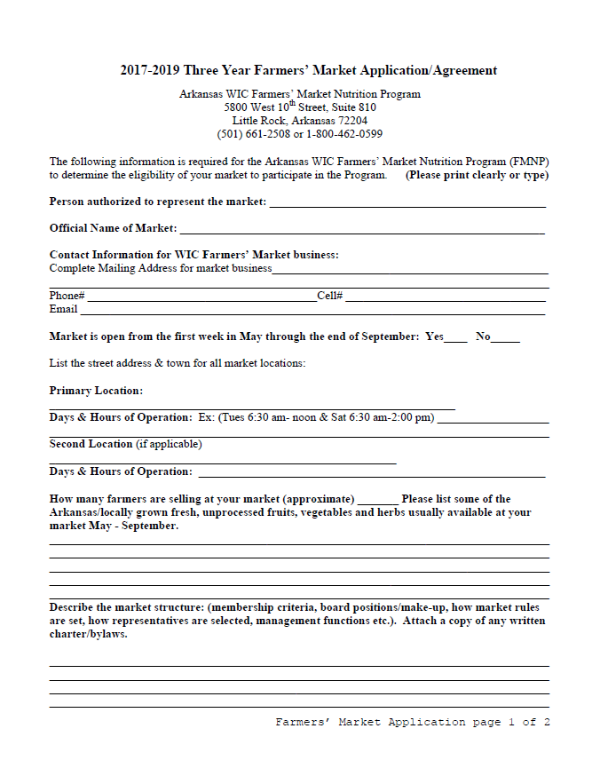
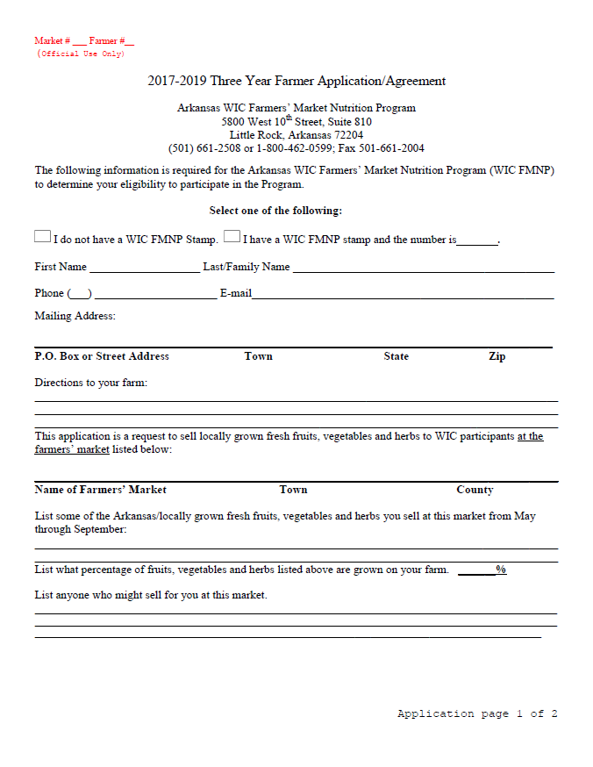
WIC FMNP
2017-2019 Farmer Training
Farmers and Markets Apply
3-Year Agreement
Notes:
Blank AR market and farmer apps are on your flash drives . . .

Slide 8
WIC FMNP
2017-2019 Farmer Training
How WIC FMNP works:
WIC participants receive coupons from WIC.
Participants use coupons to buy fresh produce at authorized farmers markets from authorized farmers.
Farmers deposit coupons in their banks to receive payment.

Slide 9
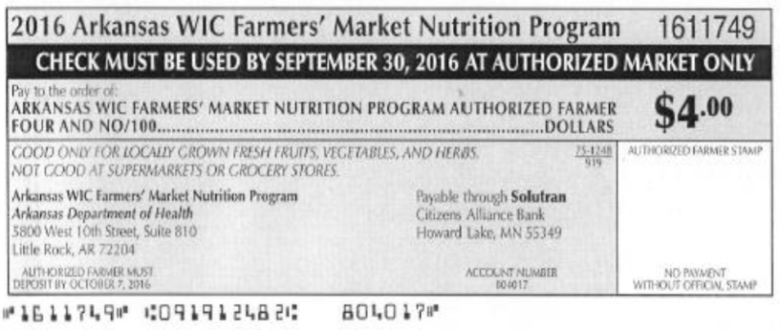
WIC FMNP
2017-2019 Farmer Training
Each WIC FMNP participant receives $16 to spend
May through September.
Notes:
Make sure you do not accept the Fruit and Vegetable Cash Value Benefits (CVBs) that WIC participants may use at grocery stores.

Slide 10
Items MUST be on this list . . .
WIC FMNP
2017-2019 Farmer Training

Slide 11
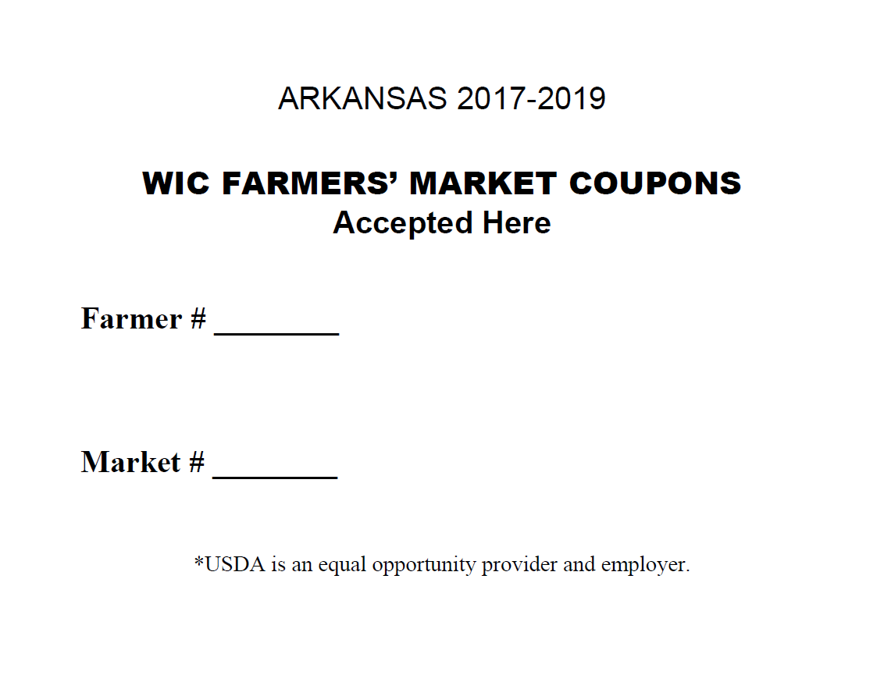
WIC FMNP
2017-2019 Farmer Training
Farmers:
Must display the current WIC FMNP Poster at their booth.
Write the market number and the farmer number on the WIC Poster (listed on the approval letter sent in the mail.)

Slide 12
WIC FMNP
2017-2019 Farmer Training
Accept FMNP checks May 1 - September 30.
The FMNP coupons will say “2017 Arkansas WIC Farmers’ Market Nutrition Program” .
Farmers cannot accept Cash Value Benefits (CVBs). They will not be paid for CVBs under any circumstances.

Slide 13
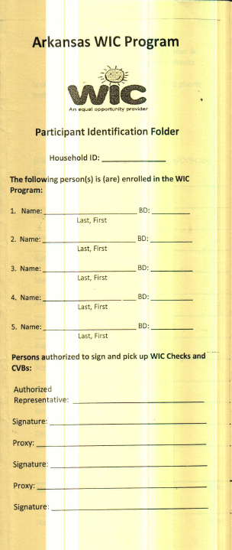
WIC FMNP
2017-2019 Farmer Training
Vendors DO NOT request the yellow booklet as they did in the past!

Slide 14
WIC FMNP
2017-2019 Farmer Training
Charge WIC participants the same price as other customers.
No sales tax may be charged on any FMNP coupon purchase.
No change may be given for any FMNP coupon purchase.

Slide 15
WIC FMNP
2017-2019 Farmer Training
The purchase should be as close to the value of the FMNP coupon(s) as possible.
If the purchase is more than the value of the FMNP coupon(s), the WIC participant may pay the difference with their own money.
Example: You may not give $3 worth of produce for a $4 coupon !

Slide 16
WIC FMNP
2017-2019 Farmer Training
Treat WIC participants with the same courtesies as other customers.
Allow WIC participants to select their food the same way as other customers.
Discrimination against WIC participants on the basis of race, color, national origin, sex, disability, age, or reprisal or retaliation for prior civil rights activity in any program or activity conducted or funded by USDA is prohibited.

Slide 17
WIC FMNP
2017-2019 Farmer Training
Be sure your coupons are stored safely to prevent theft or loss.
Deposit coupons weekly if possible to allow time for any problems with payment to be identified and addressed before payment deadline.

Slide 18
WIC FMNP
2017-2019 Farmer Training
The last day you can accept FMNP coupons is September 30.
The last day to deposit coupons during 2016 is October 6.

Slide 19
WIC FMNP
2017-2019 Farmer Training
Submitting FMNP checks for payment
Stamp each FMNP coupon with the rubber stamp provided by the FMNP with the individual farmer identification number.
Endorse the back of the FMNP coupon just as you would any other FMNP check.
Deposit the FMNP coupons in your bank weekly if possible. Deposit as you would any other check.
Be careful not to “smudge” your stamp!

Slide 20
WIC FMNP
2017-2019 Farmer Training
Payment for checks will be denied for:
Failing to stamp FMNP coupons with the farmers’ approved FMNP stamp.
Depositing FMNP coupons for unauthorized farmers or other vendors.
Failing to deposit FMNP coupons before the first Friday in October.
Altering FMNP coupons.
Depositing FMNP coupons from a previous year.

Slide 21
WIC FMNP
2017-2019 Farmer Training
Violations include:
Treating WIC participants differently from other customers.
Providing WIC participants food valued substantially below the value of checks received.
Charging WIC participants sales tax on food purchased with FMNP checks.
Failing to visibly post the current WIC FMNP poster (including their Farmer Number and Market Number) at their farmers’ market booth.

Slide 22
WIC FMNP
2017-2019 Farmer Training
Violations (cont.):
Providing unauthorized food or other items in exchange for FMNP checks.
Accepting FMNP checks at locations other than the farmers’ market(s) listed on the approval letter for the current year.
Failing to abide by any other requirement listed in this Agreement and the current Farmer Handbook.

Slide 23
WIC FMNP
2017-2019 Farmer Training
Farmers will receive a written warning for each observed violation.
Markets will receive a written warning if 35% or more of approved farmers receive violations during a monitoring visit.
Two warnings in the same year will result in termination from the program for the remainder of the current year.
Three or more warnings in the same or consecutive years will result in termination for the remainder of the current year, and the farmer or market will be ineligible to apply the following year.

Slide 24
WIC FMNP
2017-2019 Farmer Training
Fraud:
Any farmer or farmers’ market that commits fraud or abuse is liable for prosecution under applicable Federal, State or local laws. A farmer may be terminated from the FMNP and assessed claims for fraud. Examples:
Submitting FMNP checks for payment for an unauthorized farmer or vendor.
Purchasing FMNP checks for cash.
Providing drugs, alcohol or other illegal substance in exchange for FMNP checks.

Slide 25
WIC FMNP
2017-2019 Farmer Training
Appeals:
Made in writing and submitted to:
FMNP
5800 W. 10th Street, Suite 810
Little Rock, AR 72204
within 15 days of the adverse action.

Slide 26
Hope to See You at the Markets!

